Slide 1
Basic Knowledge in Python

Slide 2
Learning target
This chapter introduces::
Comment
Escape symbol
Data type
Basic operators
The difference between = and ==
Indentation
Multi-line representation

Slide 3
Comment
Comment is a short description added to the code for the readability
It is good for you and others to check the code
Comment symbol
Tell the Python compiler to ignore the text or comments following it

Slide 4
Comment
Single line Comment
Multi-line comment
Using a multi-line string by triple (single or double) quotes
Triple quotes are treated as regular strings with the exception that they can span multiple lines
When the multi-line string is not assigned to a variable, the string will be immediately garbage collected as code executes
# Comments start with a #
a = 10 # Comments can be placed at the end of a line
a = 10
''' multi-line
string '''
c = 2
""" another multi-line string
"""

Slide 5
Escape sequences
Escape sequence | Character represented
\a | Bell character
\b | Backspace character
\f | Formfeed character
\n | Newline character
\r | Carriage return character
\t | Tab character
\v | Vertical Tab character
\\ | Backslash character
\? | Question mark character
\' | Single-quote character
\" | Double-quote character

Slide 6
Typesetting of the output
The output result can be typeset by Newline(\n), Tab(\t), or blank
Clear to read and check

Slide 7
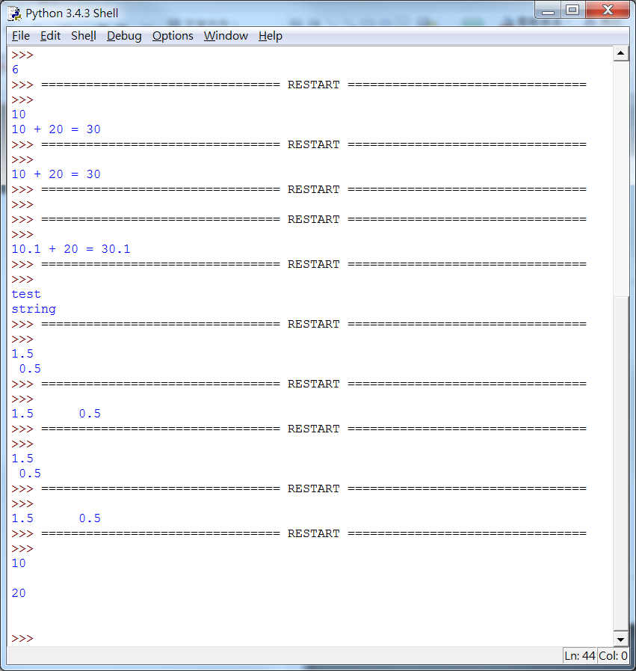
Typesetting of the output
E.g:
Result:
num1=10 # Integer variable 1
num2=20 # Integer variable 2
print(num1)
print() # Line wrapping method 1
print(num2)
print("\n") # Line wrapping method 2
print(num1)
print()
print(num2)
print("\n")

Slide 8
Data type
During the execution of the program, a lot of information needs to be calculated and stored
The information is stored in the memory space
The required format vary with different types of data
Data type is designed for different types of data

Slide 9
Data type
Integer
Floating point number
String
Complex

Slide 10
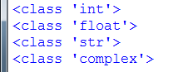
Data type
Integer = 100 # Integer
Float = 1000.0 # Floating point String= "John" # A list of characters
Complex= (-1+2j) # Complex number
print(type(Integer))
print(type(Float))
print(type(String))
print(type(Complex))
E.g:
Result:
print(type(Integer))
print(type(Float))
print(type(String))
print(type(Complex))

Slide 11
Basic operators
Arithmetic operators
Used in integers and floating-point numbers
The calculation results are also integers or floating-point numbers
Bitwise operators
Operate on the operands that are streams of binary bits (each bit is zero or one)

Slide 12
Basic operators
Assignment operator
Assign the value on the right side of the equal sign to the variable on the left
Relational operator
The result obtained by the equality or relational operator is Boolean value that is True or False

Slide 13
Basic operators
Arithmetic Operators:
Operators | Features | Example
+ | Addition | a + b
- | Subtraction | a - b
* | Multiplication | a * b
/ | Division | a / b
// | Floor division | a // b
% | Modulus | a % b

Slide 14
Basic operators
Logical Operators :
Operators | Features | Example
<< | Bitwise Left Shift | a << n
>> | Bitwise Right Shift | a >> n
& | Bitwise AND | a & b
| | Bitwise OR | a | b
^ | Bitwise XOR | a ^ b

Slide 15
Basic operators
Assignment operator :
Operators | Features | Example
= | Assign | a = b
+= | Add and assign later | a += b
-= | Subtract and assign later | a -= b
*= | Multiply and assign later | a *= b
/= | Divide and assign later | a /= b
%= | Get the remainder and assign later | a %= b

Slide 16
Basic operators
Assignment operator :
a=a+b equivalent to a += b
a=a-b equivalent to a -= b
a=a*b equivalent to a *= b
a=a/b equivalent to a /= b
a=a%b equivalent to a %= b

Slide 17
Basic operators
Relational operator :
Operators | Features | Example
< | Less than | a < b
> | Greater than | a > b
<= | Less than or equal to | a <= b
>= | Greater than or equal to | a >= b
== | Equal | a == b
!= | Not equal | a != b
and | and | (a>0)and(b>0)
or | or | (a>0)or(b>0)

Slide 18
The difference between = and ==
= symbol is used to assign a certain value to a variable
The == symbol is used to compare the left and right operands to see if they are equal or not

Slide 19

The difference between = and ==
Example:
Result:
integer=1 #Set the integer variable to 1
if(integer==1): #Test the equality of the variable integer and 1
print("integer equal 1")

Slide 20
Indentation
Indentation in Python refers to the spaces and tabs that are used at the beginning of a statement
The statements with the same indentation belong to the same group called a suite

Slide 21
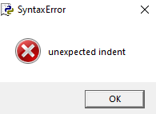
Indentation
E.g :
E.g :
#An example of python code with correct indentation
if a==1:
print(a)
if b==2:
print(b)
print('end')
#An example of python code with wrong indentation
a = 1
print(a)
a = 3# Multiple blanks, resulting in an error print(a)

Slide 22

Multi-line representation
Example :
Result:
one=1
two=2
three=3
# Use \ to connect to the next line of code
# Press Enter to automatically align
total = one + \
two + \
three
print(total)

Slide 23
Source
References
http://openhome.cc/Gossip/CppGossip/DataType.html
http://pydoing.blogspot.tw/2014/07/python-guide.html
http://www.w3cschool.cc/python/python-tutorial.html
https://msdn.microsoft.com/zh-tw/library/bx185bk6.aspx
Python 深入淺出程式設計

Slide 24
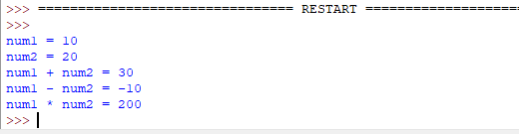
Exercise 1
Design a program, where you have to declare two integer variables, one is set to 10 and the other is set to 20. Output the result of the addition, subtraction, and multiplication of the two variables.
Result:

Slide 25
Exercise 2
Design a program that can print the multiplication table as follows.
Result:
1 2 3 4 5 6 7 8 9
1 1*1=1 1*2=2 1*3=3 1*4=4 1*5=5 1*6=6 1*7=7 1*8=8 1*9=9
2 2*1=2 2*2=4 2*3=6 2*4=8 2*5=10 2*6=12 2*7=14 2*8=16 2*9=18
3 3*1=3 3*2=6 3*3=9 3*4=12 3*5=15 3*6=18 3*7=21 3*8=24 3*9=27
4 4*1=4 4*2=8 4*3=12 4*4=16 4*5=20 4*6=24 4*7=28 4*8=32 4*9=36
5 5*1=5 5*2=10 5*3=15 5*4=20 5*5=25 5*6=30 5*7=35 5*8=40 5*9=45
6 6*1=6 6*2=12 6*3=18 6*4=24 6*5=30 6*6=36 6*7=42 6*8=48 6*9=54
7 7*1=7 7*2=14 7*3=21 7*4=28 7*5=35 7*6=42 7*7=49 7*8=56 7*9=63
8 8*1=8 8*2=16 8*3=24 8*4=32 8*5=40 8*6=48 8*7=56 8*8=64 8*9=72
9 9*1=9 9*2=18 9*3=27 9*4=36 9*5=45 9*6=54 9*7=63 9*8=72 9*9=81

Slide 26
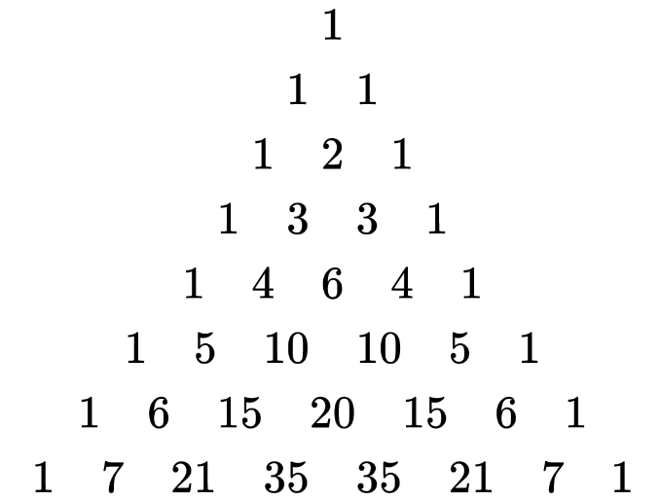
Exercise 3
Design a program that can print the Pascal’s triangle with rows 0 through 7, as follows.
Result :

